Slide 1

Notes:
You may want to conduct pretest using the very last slide page.
PREPARATION:
Yes/No cards (I have students make these and keep in their desk)
Copy exit slip

Slide 2

One-
Sentence
Summary
Verdi
wanted
to be yellow,
but
he was turning green no matter how he tried to stop it,
and so he learned
changing your outside appearance doesn’t change who you are naturally.
Notes:
DAY 1
T: Today, we are going to introduce 3 new words used in Verdi. First, we want to refresh our brains and review the story of Verdi. With your shoulder partner, I want partner A to do the “somebody,” partner B to do the “wanted,” and alternate the last two sections. Retell the one-sentence summary to one another until the timer goes off. (Set timer for 30 seconds minutes- I use http://www.online-stopwatch.com/).
Circulate and eavesdrop providing assistance as needed.
Choose a way to share a few responses: 1) Groups who had good examples share 2)Have groups who had good examples alternate the summary parts 3)Have the whole class attempt to alternate one summary However, you do it, this is a good time to talk about the difficulty of creating a succinct summary and really “zooming” in on the big ideas of the story.
Display teacher solution and compare class solution.

Slide 3

frantic
Context: His frantic splashing caught the eye of a large bottom feeder cruising the murky depths.
Definition: (adjective) wild or rushed behavior because you are frightened, worried, or in a hurry
Notes:
T: Our first word is frantic. (fran-tic)
T: Say “frantic” with me.
T: In the story “Verdi,” frantic is used in the following way: click to read context; read context.
Click again for definition; read definition.
T: I notice that Verdi is splashing which usually requires a lot of movement and the fish at the bottom notices his wild movement, so I know that frantic must mean there is a lot of wild behavior going on!
T: Sometimes in the morning people can behave frantically if they are running late for work.
T: I also remember losing my purse one time…that made me worry like crazy! My credit cards, check book, everything missing?
Click for student shared activities.

Slide 4
frantic
Falling into a pool of sharks
Eating dinner with family
Describe a time you were frantic.
A tornado outside the school
Reading a book
The student was frantic because_________.
Notes:
T: Now it’s your turn! As I give you a situation, if you would feel frantic say “frantic.” If not, say, “No Way.” Click once for each new clue.
T: Turn and talk to partner to complete the sentence. Click for prompt.
Circulate one minute; share 2 responses.
T: Turn and talk to partner about this statement. Click for prompt.
Circulate 1 minute; share 2 responses.
Click for last slide reviewing frantic.

Slide 5
What’s our word that means “wild, rushed behavior because you are frightened, worried or in a hurry?”
frantic
Notes:
Read slide. Click to display BIG word after choral response!

Slide 6

antics
Context: “Plummeting through the trees, Verdi landed in a crooked sprawl across a log on the forest floor. He couldn’t move. “Help” he croaked. As usual the greens had been watching Verdi’s antics.
Definition: (noun) funny, silly or unusual behavior
Notes:
T: Our second word is antics. (an-tics)
T: Say “antics” with me.
T: In the story “Verdi,” antics is used in the following way: click to read context; read context.
Click again for definition; read definition.
T: Right before this passage, I remember Verdi was doing all sorts of silly things while the greens watched and thought he silly and young he was. That helps me figure out that antics are the silly behaviors someone is displaying.
T: I think we’ve seen a few examples of antics in here this year! Fill in your example.
T: Many times siblings are guilty of silly behaviors, or antics, that annoy their brothers and sisters and lead to bigger arguments!
Click for student shared activities.

Slide 7
antics
Brushing your teeth
Walking backwards all day
What antics might get you in trouble?
Writing a letter
Burping aloud the alphabet
Where might you see someone’s antics? Give an example.
Notes:
T: Now it’s your turn! As I give you a situation which you believe are antics say “antics.” If not, say “No Way.” Click once for each new clue.
T: Turn and talk to partner. Click for prompt.
Circulate one minute; share 2 responses.
T: Turn and talk to partner about this statement. Click for prompt.
Circulate 1 minute; share 2 responses.
Click for last slide reviewing antics.

Slide 8
What’s our word that means, “funny, unusual or silly behavior?”
antics
Notes:
Read slide. Click to display BIG word after choral response!

Slide 9

snicker
Context: “Get a load of that old green guy,” one of them whispered. “Do you think he ever moves?” the other snickered. “I seriously doubt it!”
Definition: (verb) to laugh quietly and disrespectfully at someone or something
Notes:
T: Our third word is snickered. (snick-ered)
T: Say “snickered” with me.
T: In the story “Verdi,” snickered is used in the following way: click to read context; read context.
Click again for definition; read definition.
T: I can tell that these young snakes think Verdi is just an old cranky green by their comment, “Do you think he ever moves?” and then they snicker. This helps show me that snickering is not a friendly laugh…they are clearly making fun of him.
T: When someone trips, I’ve seen people snicker. This is a good example of laughing AT someone, not WITH them, which is a lot like snickering. (but it’s done quietly)
T: I once snickered at my mom for spilling coffee on her shirt, and she got MAD!
Click for student shared activities.

Slide 10
snicker
Laughing at someone’s new hair color
Laughing at your dog chasing his tail
Laughing at a classmate’s mistake
Laughing at a funny joke
The fifth grader snickered because
_______.
What does someone who snickered look like?
Notes:
T: Now it’s your turn! As I give you each situation, if you might hear a snicker, say “snickered.” If not, say “No Way.” Click once for each new clue.
T: Turn and talk to partner to complete sentence. Click for prompt.
Circulate one minute; share responses.
T: Turn and talk to partner about this statement. Click for prompt.
Circulate 1 minute; share responses.
Click for last slide reviewing snickered.

Slide 11
What’s our word that means “to laugh quietly and disrespectfully at someone or something?”
snicker
Notes:
Read slide. Click to display BIG word after choral response!

Slide 12
Challenge!
With your partner use all three words together in a sentence or short story.
Notes:
I allow 5 minutes for this activity and provide time for sharing at the end. A three sentence limit works well. The more students do this, the better they get!
EXAMPLE: I snickered at my mother’s frantic antics while she was preparing for her big speech!

Slide 13
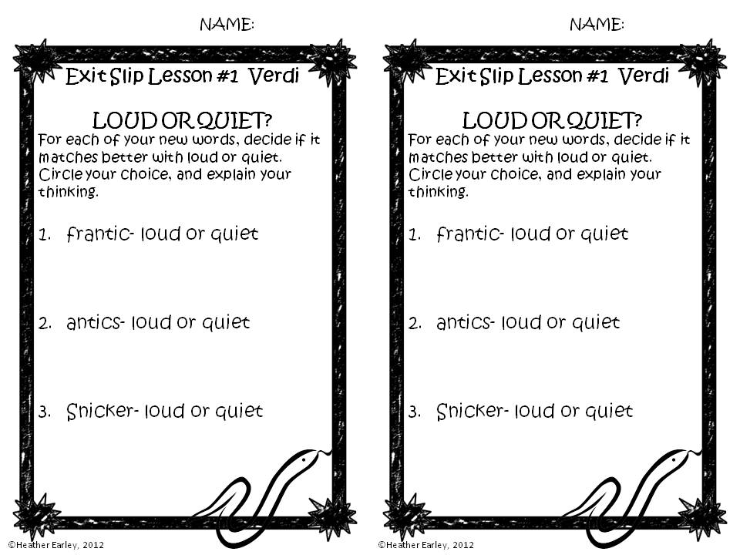

Slide 14
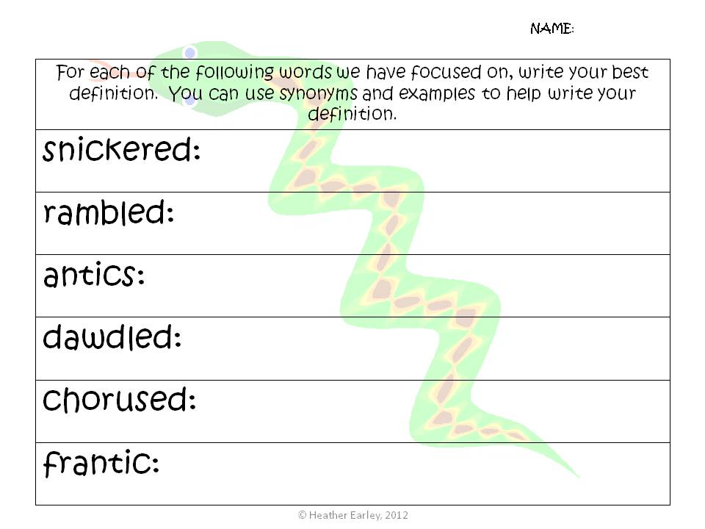

Slide 15
